Slide 1
Therapeutic Recreation Ontario (TRO) Annual General Meeting 2023
Wednesday, June 7, 2023

Slide 2
to
TRO’s
2023

Slide 3
2023 AGM Agenda
 | Agenda Item | Presenter | Time Allotted
1 | Welcome, Call to Order and Confirmation of Quorum | Katherine Lee | 12:00 – 12:05 PM (5 min)
2 | Approval of 2023 AGM Agenda | Katherine Lee | 12:05 – 12:10 PM (5 min)
3 | Approval of 2022 AGM Minutes | Katherine Lee | 12:10 – 12:15 PM (5 min)
4 | President’s Remarks | Katherine Lee | 12: 15 – 12:25 PM (10 min)
5 | Introduction of the 2023-2024 Board of Directors | Katherine Lee | 12: 25 – 12:35 PM (10 min)
6 | Financial Report | Sue Talmey | 12:35 – 12:40 PM (10 min)
7 | TRO’s Annual Report (Video) | Katherine Lee | 12:40 – 12:50 PM (10 min)
8 | Other Business | Melissa Enmore | 12:50 – 12:55 PM (5 min)
9 | Question and Answer Segment | Melissa Enmore | 12:55 – 12:59 PM (4 min)
10 | Adjournment of Meeting | Katherine Lee | 12:59 – 1:00 PM (1 min)
Reminder: TRO’s members set the direction for the direction at the Annual General Meeting (AGM)

Slide 4
1. Call to Order and Confirmation of Quorum
AGM attendee to move the motion to call the meeting to order
AGM attendee to second the motion

Slide 5
2. Approval of the 2023 AGM Agenda
AGM attendee to move the motion to approve the agenda
AGM attendee to second the motion

Slide 6
3. Approval of the 2022 AGM Minutes
AGM attendee to move the motion to approve the 2021 AGM minutes
AGM attendee to second the motion

Slide 7
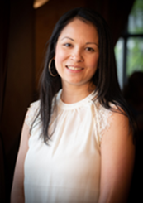
4. President’s Remarks
Katherine Lee, R/TRO
TRO’s Board President 2022/2023

Slide 8
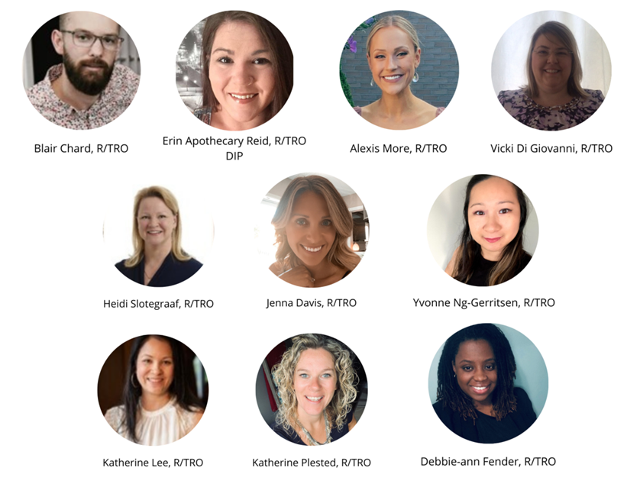
TRO’s Current Board of Directors
TRO’s 2022-2023 Board of Directors:
Katherine Plested, R/TRO – President
Debbie-Ann Fender, R/TRO – Vice President
Jenna Davis, R/TRO - Secretary
Katherine Plested, R/TRO – Past President
Alexis More, R/TRO
Blair Chard, R/TRO
Erin Apothecary Reid, R/TRO
Heidi Slotegraff, R/TRO
Vicki Di Giovanni, R/TRO
Yvonne Ng-Gerritsen, MA, CTRS, R/TRO

Slide 9
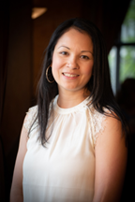
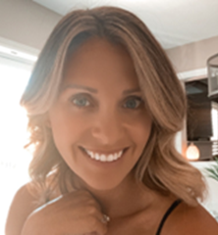
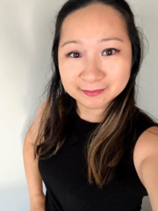
5. Introduction of the 2023-2024 Board of Directors
-
Executive Committee Members
TRO’s 2023-2024 Board of Directors
TRO’s 2023-2024 Executive Committee Members
 | Name of Board Member | Board Position
1 | Katherine Lee, R/TRO | President
2 | Jenna Davis, R/TRO | Vice President
3 | Yvonne Ng, Gerristen, MA, CTRS, R/TRO | Secretary
Katherine Lee, R/TRO
Jenna Davis, R/TRO
Yvonne Ng-Gerristen, MA, CTRS, R/TRO

Slide 10
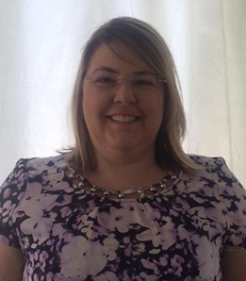
5. Introduction of the 2023-2024
-
Board at Large
TRO’s 2023-2024 Board of Directors (cont’d)
 | Name of Board Member | Board Position | Year of Term
1 | Suneel Saini | Director-at-Large | 1st Year of Term
2 | Victoria DePass | Director-at-Large | 1st Year of Term
3 | Callum Thomson | Director-at-Large | 1st Year of Term
4 | Vicki Di Giovanni | Director-at-Large | 2nd Year of Term
5 | Erin Apothecary-Reid | Director-at-Large | 2nd Year of Term
*Reach out for photos*
Suneel , R/TRO
Victoria,
R/TRO
Callum,
R/TRO
Vicki Di Giovanni, R/TRO

Slide 11
6. Financial Report
Sue Talmey, CPA, CMA

Slide 12
7. TRO’s Annual Report
Video Link:

Slide 13
8. Other Business and Q&A Segment
Strategic Planning Update
2-1 Designation Change
TRO’s 3-Year Roadmap – The Path Ahead

Slide 14
Strategic Planning Outputs
Vision:
Therapeutic Recreation
for All
Professional Development
Advocacy
Sustainable Growth
New
Mission: Empowering TRO stakeholders through advocacy, professional development & sustainable growth
Notes:
Vision: Therapeutic recreation for all
Mission: Leading the TR profession through growth, advocacy and innovation
Strategic pillars = Technology, engagement, advocacy, sustainable growth

Slide 15
Strategic Planning Outputs – TRO’s Values
Respect
Integrity
Transparency
Empowerment & Dependability
Diversity, Equity, Inclusion, Belonging
(DEIB)
New
Notes:
Vision: Therapeutic recreation for all
Mission: Leading the TR profession through growth, advocacy and innovation
Strategic pillars = Technology, engagement, advocacy, sustainable growth

Slide 16
TRO’s High Level Timeline for 2023
Private Practice Webinar Series
TR Awareness Month Activities
&
Regional
Meet-Ups
Lobby Day at Queens Park
2-1 Applications Resume
Conference Preparation
+
Designation Application Reviews
Conference (Toronto)
Summer Break
2-1 Applications Resume
+
Soft Launch of Student Network
School Presentations
Jan
Feb
Mar
Apr
May
Jun
Jul & Aug
Sep
Oct-Dec
Launch of New AMS &
Website
Webinars
&
Regional Meet-Ups

Slide 17
Historical Overview of the Designation Transition
TRO Designation Review Committee Established
2-1 Working Group
Established
2018
2019
2020
2021
2022
2023
2024
2018 – 2021
Review of our existing designations & application process
2021
Recommendation to move to a single designation
2022 – 2024
2-Year Transition Period

Slide 18
The Transition from 2 Designations to One
Previously:
2 Designations
Currently:
1 Designation
R/TRO
+
R/TRO DIP
R/TRO
R/TRO DIP
R/TRO Designation

Slide 19
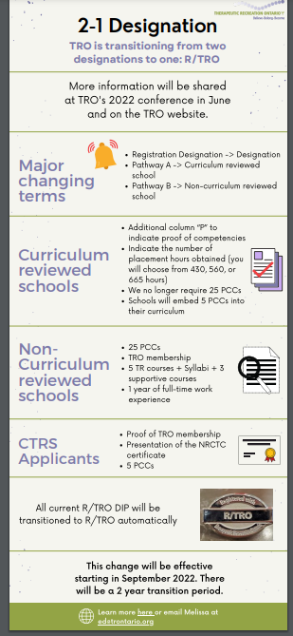
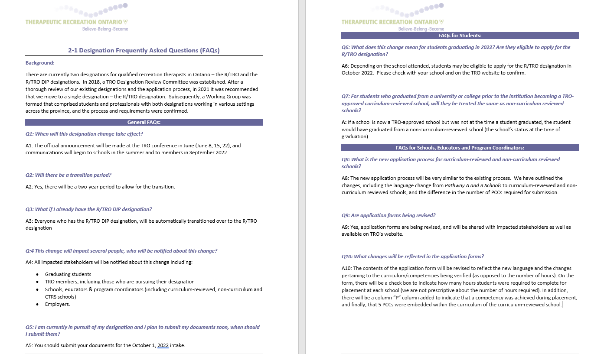
2-1 Designation Supporting Materials
Notes:
– remove non-curriculum reviewed schools & CTRS applicants; remove # hours from the infographic
Purpose of R/TRO and benefits to a member - is to elevate our profession ; meet minimum quality of practice; demonstrating professional development and commitment to the profession
Keep up with the maintenance every 5 years
TRO supports 12 diploma programs and 3 degrees programs across Ontario
Diploma programs
Webinar led by Sue V., Vicki & Debbie, Kat – panel discussion

Slide 20
R/TRO Designation Communications Timeline (2023)
Audience | Venue | Feb | Mar | Apr | May | Jun | Jul | Aug | Sep | Oct
Educators - TREPS Committee | Zoom Meeting (Quarterly Meetings)
TR Students | EIP Presentations & Student Network
TRO Members | Website + e-TRO Updates (Infographics & FAQ, App. Form)
 | Webinar (Sue V.)
 | Conference
Applications | Online Submission and Review of Applications
Employers | Emails – Letters to Employers
Quarterly Meetings
Quarterly Meetings
EIP Presentations
EIP Presentations
Student Network
Website & e-TRO Updates
*New Website* & e-TRO Updates
Feb 1
Conference Updates
1st Intake of New Apps
Review of Applications
Comms to Employers

Slide 21
TRO’s 3-Year Roadmap
Alignment with CTRS, Provincial Orgs & CTRA
Continued Partnerships with Colleges & Universities
Designation Transition
Engage with & Educate Employers about TRs’ Role
Continued Government Partnerships
Explore Additional University TR Programs
Continue to Support & Engage with Students & Educators
Explore Title Protection
Elevate TRO’s Profile, & Invest in Sustainability (Financial & Members)
More Curriculum-Reviewed Schools

Slide 22
9. Q&A Segment

Slide 23
10. Adjournment of Meeting
AGM attendee to move the motion to adjourn the meeting
AGM attendee to second the motion

